Slide 1
Model View Controller (MVC) Design Pattern
Crystal Tenn
Crystal.Tenn@microsoft.com

Slide 2
What is the Model View Controller (MVC) design pattern?
Controller
1. User action via view
2. Request model to change
5. Updated model state
4. Updated model state
View
Model
6. Updates UI component(s) to reflect updated model state
3. Model updates in response to controller request

Slide 3
Controller

Slide 4
What is a Controller?
Simple .NET class that orchestrates entire request
Exposes 1-to-many public methods called Action Methods…
Each Action Method returns an Action Result… (HTML, JSON, string, file, etc.)
Action Method
Action Filter
Public class CustomerController : Controller
{
[HttpPost]
public ActionResult Create(Model model)
{
//…. Receives and processes submitted data
return view(“Create”);
}
}
Action Parameter
Action Result
Notes:
Estimated Time: 4 minutes
Talking Points:

Slide 5
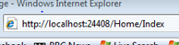
Invoked from Routing Engine
Controllers/Actions are URL-Addressable…
Routing engine parses URL: /home/index
Maps to corresponding controller and action method
Returns an “action result“
public class HomeController : Controller
{
public ActionResult Index()
{
ViewBag.Message = "Welcome!";
return View();
}
public ActionResult Retrieve(int id)
{
// Code that retrieves customer by id
return View(“Retrieve”, dataFile);
}
}
Both controller and action
are URL Addressable
Notes:
Estimated Time: 4 minutes
Talking Points:
Each controller/action method maps to a unique URI

Slide 6
Action Methods
Controller exposes 1 to many Action Methods
Operations that controller can perform
Each method corresponds to an operation
Each Action Method returns Action Result type
public class CustomerController : Controller
{
public ActionResult Get(int Id)
public ActionResult GetAll()
public ActionResult Add(Customer customer)
public ActionResult Edit(Customer customer)
public ActionResult Delete(Customer customer)
}
Notes:
Estimated Time: 4 minutes
Talking Points:

Slide 7
Action Result
Base type for variety of common return types
Action method returns required child action result
Derived Type | Behavior | Payload
ViewResult PartialViewResult | View engine prepares response | HTML
ContentResult | Renders raw content | String
FileContentResult | Returns file content | File
JsonResult | Renders data as Json | JSON
JavaScriptResult | Returns script to execute | JavaScript
RedirectResult | Redirects to another URL | Redirect
HttpNotFoundResult | Returns HTTP 404 status code | 404 Code
HttpUnauthorizedRequest | Returns HTTP 403 status code | 403 Code
EmptyResult | No response | Nothing

Slide 8
Action Selectors
Updateable views expose multiple ActionMethods
Differentiate with HTTP Accept Verbs (Filters)
Specifies ActionMethod a controller should invoke
HTTP GET: Retrieves data only (read only)
HTTP POST: Submits data to server (changes state on server)
[HttpGet]
public ActionResult Create()
{
//…. Returns blank form for input (think of as read-only operation)
}
[HttpPost]
public ActionResult Create(Model model)
{
//…. Receives and processes submitted data
}
Action method invoked
for Get operation
Action method invoked
for Post operation
Notes:
Estimated Time: 4 minutes
Talking Points:

Slide 9
Model

Slide 10

What is the Model?
Overloaded term -- refers to…
Model Layer - Service layers (BAL, DAL, DB) that provide compute, business and data storage operations
Model Data - Domain data object returned from operation and passed to View for presentation
Model Data
Model Layer
Service Layer
Controller
Data
Repositories
Services
Data
Presentation Data
Data
Internet
View
Notes:
Estimated Time: 4 minutes
Talking Points:
Model refers to the components that contain business, validation and data access logic
Model also refers to data object to which the View will bind
The bulk of development time will be spent building model functionality

Slide 11
Presentation Model
For now…
Think about the model as a data object
Passed back from the service layer
Passed into view
With view, strongly type to model
Model Data
Controller
Data
Data
Presentation Data
View
Notes:
Estimated Time: 4 minutes
Talking Points:
Model refers to the components that contain business, validation and data access logic
Model also refers to data object to which the View will bind
The bulk of development time will be spent building model functionality

Slide 12
Loosely-Coupled Approach
Controller can pass small amounts of data to View
Assign data in Controller and access in View
ViewData – Dictionary of objects
ViewBag – Dynamic object
ViewData
Name/Value Dictionary
No compile time check
Key Names are strings
Requires casting/boxing
ViewBag
Supports dynamic types
Predefined classes not needed
No compile time check
No IntelliSense
Only supported in .NET 4
Notes:
Estimated Time: 4 minutes
Talking Points:

Slide 13
MVC Input Validation
Exposes built-in layer of declarative validation services
Leverage without writing any code
Centralize by decorating model with validation attributes…
Validation code automatically generated…
Both client- and server-side…
Built-in remote validation plumbing
Extensible – “roll your own” custom validation services
Server
Validation
Client Validation
Remote Validation
Custom
Validation
Notes:
Estimated Time: 5 minutes
Talking Points:

Slide 14
Validation by Annotation
Add by applying built-in validation attributes to model properties
public class StudentViewViewModel
{
[Required(ErrorMessage = "First Name is required.")]
[Display(Name = “Student First Name")]
[MinLength(2, ErrorMessage = "First name must be at least 2 characters")]
[MaxLength(35, ErrorMessage = "First name cannot exceed 35 characters")]
public string FirstName { get; set; }
}
Notes:
Estimated Time: 4 minutes
Talking Points:

Slide 15
Built-In Validation Types
Large number of validation types are built into MVC framework:
Attribute | Description
Required | Makes data item required
Display | Applies friendly name to labels
Min/Max Length | Applies max/min length to data
DisplayFormat | Applies DataFormatString to data
RegularExpression | Applies regular expression to data
DataType | Applies specific data type to data (DataType.Password)
ReadOnly | Makes data item read-only
AllowAnonymous | Negates [Authorize] and allows access – Login/Register
Notes:
Estimated Time: 4 minutes
Talking Points:

Slide 16
View

Slide 17
What is a View?
A template - contains no logic or computations
Single responsibility: Generating HTML
Combines markup/data, generates HTML
@model ArticleViewModel
<h2>Welcome to MVC Blog!</h2>
@foreach (var item in Model.Articles){
<div>
<h3>@item.Title</h3>
<div>
@item.Body
</div>
Posted:
@item.Published.ToLongDateString()
@item.Published.ToShortTimeString()
@item.Author
@item.CommentCount Comments
</div>
}
@model directive: Specifies
strongly-type model file
Mixes HTML and code
Data elements bind to
properties from the model file
Notes:
Estimated Time: 4 minutes
Talking Points:

Slide 18
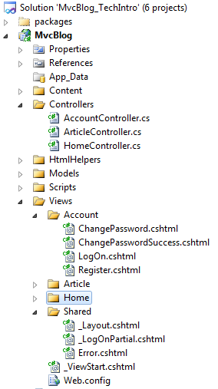
View Conventions
Views live in sub-folders, beneath the view folder, that correspond to controller names
Each view corresponds to a name of an action method
Views that are shared across controllers live in the shared directory
View names that being with an underscore are partial views and must be called from within a view
Notes:
Estimated Time: 2 minutes
Talking Points:

Slide 19
What is a View Engine?
Component that locates and parses a view template file, physically building output for the browser
Controller
specifies
view and
injects
model
Locates View
Locates Layout
Executes View
Injects
data with
markup
Returns HTML
Tasks Performed by the View Engine
Notes:
Estimated Time: 4 minutes
Talking Points:

Slide 20
Pluggable View Engines
View Engine is pluggable component in the MVC architecture
Web Forms
Engine
Razor
Web Forms
Engine
Spark
NHaml
NDJango
Web Forms
MVC
ASP.NET
.NET Framework
Notes:
Estimated Time: 4 minutes
Talking Points:

Slide 21
Filters

Slide 22
Action Filters
Extensibility point…
Intercept the execution of an action
Inject behavior before or after code execution
Done with .NET Attributes
Similar to Aspect-Oriented programming
Additional behavior, built-in or custom, attached to controllers or action methods that declaratively extend functionality without changing code…

Slide 23
Filters
Additional behavior, built-in or custom, that attach to controllers or action methods that declaratively extend functionality without changing code…
Authorization Filters
Make security decisions before executing action method code
Action Filters
Invoked before/after action method code execution
Inspect operation allowing for conditional or additional processing
Result Filters
Invoked before/after action result code execution
Inspect return values, cancel operation or perform additional processing
Action Selectors
Selects the action method that will be invoked
Exception Filters
Executes when unhandled exception is raised
Great for implementing logging and rendering a custom error view
Notes:
Result filter: OutputCacheAttribute
Exception filter: HandleErrorAttribute

Slide 24
Authorization Filter
Built-in attribute – attach to controller or action method
Restricts access to only authenticated users
Redirects unauthenticated users to a logon page
Optionally restrict access to users in specific role
[Authorize(Roles=“Admin”)]
User must be authenticated and member of Admin role
[Authorize]
public ActionResult Create() {…}
<authentication mode="Forms">
<forms loginUrl="~/Account/LogOn" timeout="2880" />
</authentication>

Slide 25
More Built-In Filters
Extend infrastructure plumbing
[HandleError(ExceptionType = typeof(NullReferenceException), View = "NullError")]
[HandleError(ExceptionType = typeof(SecurityException), View = "SecurityError")]
public class HomeController : Controller
{
[OutputCache(Duration = 15)]
public ActionResult Index()
{
ViewData["Message"] = DateTime.Now;
return View();
}
[Authorize(Roles="Admin, SalesReps")]
public ActionResult About()
{
return View();
}
}
HandleError Filter
Redirect to custom error views
OutputCache Filter
Caches action results
Authorize Filter
Restrict Access
Notes:
Estimated Time: 5 minutes
Talking Points:
[OutputCache(Duration=10, VaryByParam="none")] //10 seconds

Slide 26

Custom Action Filters
Add pre-/post-action behavior to controller actions/results
Extend and manipulate behavior
Ideal for implementing cross-cutting functionality
public class LogMessageAttribute : ActionFilterAttribute
{
public string Message { get; set; }
public override void OnActionExecuting(ActionExecutingContext filterContext)
{ … }
public override void OnActionExecuted(ActionExecutedContext filterContext)
{ … }
public override void OnResultExecuting(ResultExecutingContext filterContext)
{ … }
public override void OnResultExecuted(ResultExecutedContext filterContext)
{ … }
}
Fires before action
Fires after action
Fires before result
Fires after result
[LogMessage(Message = "Hello from Microsoft")]
public class ArticleController : Controller

Slide 27
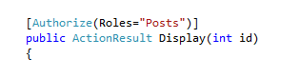
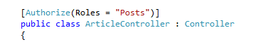
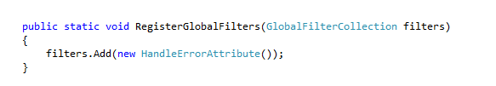
Filter Scope…
Single Action Method:
Entire Controller
Entire Application - Global filter

Slide 28
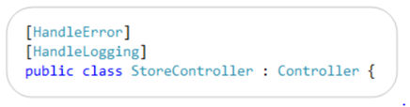
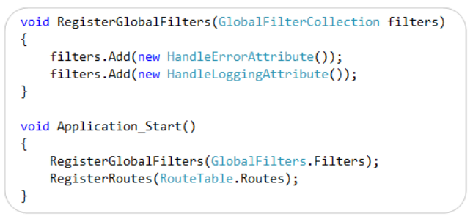
Global Filters
Global filter executes on every action request
RegisterGlobalFilters() method exposed in global.asax
Notes:
Sometimes you want to perform logic either before an action method runs or after an action method runs. To support this, ASP.NET MVC 2 provided action filters. Action filters are custom attributes that provide a declarative means to add pre-action and post-action behavior to specific controller action methods. However, in some cases you might want to specify pre-action or post-action behavior that applies to all action methods. MVC 3 lets you specify global filters by adding them to the GlobalFilters collection. For more information about global action filters, see the following resources:
Scott Guthrie's blog on the MVC 3 Preview
Filtering in ASP.NET MVC

Slide 29
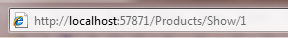
Model Binding
All About URI Segments
For HTTP “GET” Requests
GET request (via routing):
Map to URL Patterns
Port
Server
Port
Action
Controller
Id
routes.MapRoute(
"Default",
// Route name
"{controller}/{action}/{id}", // URL with parameters
new { controller = "Home", action = "Index", id = UrlParameter.Optional }
);
public class ProductsController : Controller{
public ActionResult Show(int id)
{
//.......
return View();
}
}
Map to controller, action
Notes:
Estimated Time: xx minutes
Talking Points:

Slide 30
MVC Routing Engine
Routing Engine
The mechanism with which MVC maps an incoming URL to a controller and action for request processing
Enables you to decouple your URL from the underlying directory structure and file names (.aspx).
Create meaningful, intuitive URLs that make sense for the user:
/Customer/Oregon/Edit/1001
WebForms highly dependent on directory structure and .aspx files
Performs the grunt work of matching URLs to appropriate application components
Browser
Controller
Action
Notes:
Estimated Time: 4 minutes
Talking Points:
ASP.NET Routing allows you to define a set of routes that dictate the URL patterns your application can respond to, and map them to a handler that can direct the request at the proper resource (i.e. page, controller action method, etc)
You can define your routes using both static URLs (/Products/Edit/23) as well as parameterized (/Products/Edit/{productID})
It is the route handler that is responsible for translating the requested route into an actionable resource than can respond to the request
Once you’ve defined your custom route table, you can essentially use it to generate your application’s sitemap.
If you know the resource you want, and the parameters it needs, then the ASP.NET Routing engine can generate the proper URL for you based on your route definitions
Both ASP.NET MVC and ASP.NET Dynamic Data leverage ASP.NET Routing to enable their custom URL schemes

Slide 31
MVC Routes
A Route is a predefined URL pattern, whose elements can be dynamic or static
Dynamic elements defined with placeholders enclosed in braces { }
Static elements are constant strings
An incoming URL is matched against each URL pattern, segment-by-segment, until a match is found
Route Definition | Example of Matching URL
{controller}/{action}/{id} | /Products/show/beverages
{table}/Details.aspx | /Products/Details.aspx
blog/{action}/{entry} | /blog/show/123
{reporttype}/{year}/{month}/{day} | /sales/2008/1/5
{locale}/{action} | /en-US/show
{language}-{country}/{action} | /en-US/show
Notes:
A Route represents a container for all the metadata/information the routing engine needs to determine whether it satisfies an incoming request. This includes the following:
The URL, which can optionally have parameters.
Default values for any parameters, either URL parameters, or other parameters that the route or route handler (more on this in the next slide) might be looking for.
Any constraints. These can include constraints against parameters in the URL as well as the actual request. An example of this would be confining a parameter by a regular expression pattern, or requiring the HTTP verb of the incoming request be PUT.
The actual route handler that will translate this route into a resource. The route handler is responsible for creating an HTTP handler that will ultimately serve the request, and respond to the user with the information they wanted.
For the most part you can get away with using the provided Route class to represent your routes, but if you need to extend your routes, you can either inherit from Route, or RouteBase (which is the lowest common denominator).
Because the route is responsible for determining whether it matches the current request, if you wanted to modify the logic that made that determination, you would probably want to create your own route type.
Estimated Time: 4 minutes
Talking Points:
ASP.NET Routing allows you to define a set of routes that dictate the URL patterns your application can respond to, and map them to a handler that can direct the request at the proper resource (i.e. page, controller action method, etc)
You can define your routes using both static URLs (/Products/Edit/23) as well as parameterized (/Products/Edit/{productID})
It is the route handler that is responsible for translating the requested route into an actionable resource than can respond to the request
Once you’ve defined your custom route table, you can essentially use it to generate your application’s sitemap.
If you know the resource you want, and the parameters it needs, then the ASP.NET Routing engine can generate the proper URL for you based on your route definitions
Both ASP.NET MVC and ASP.NET Dynamic Data leverage ASP.NET Routing to enable their custom URL schemes

Slide 32
MVC Routing
Execution Pipeline
Request
UrlRoutingModule
Stores Route Definitions
RouteTable
Determines Match
Route
RouteHandler
Selects HTTP
Handler
IHttpHandler
Response
Notes:
Estimated Time: 4 minutes
Talking Points:
This diagram represents the lifecycle of a request in terms of how ASP.NET Routing will process it:
A request comes in and the URL Routing Module intercepts it.
The module checks the URL against the list of all routes in the application’s route table.
If a route is found, the module gets the route’s route handler.
The module then get’s the route handler’s HTTP handler.
The HTTP handler is then responsible for serving the request.

Slide 33
What are the benefits of MVC?
Separation of concerns
Between view and model
A fundamental software engineering principle
Code that is
Easier to test
Easier to maintain
Easier to plug model into different views (e.g. for different clients like web vs. mobile)

Slide 34
MVP Design Pattern

Slide 35
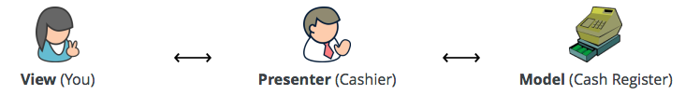
Model View Presenter Web Forms Framework
The simplest way to explain the pattern is to consider a checkout at a supermarket.
Visualise that you, the customer, are the View, the cashier is the Presenter and the cash register is the Model.
Example Reference: http://www.bradoncode.com/blog/2012/04/mvp-design-pattern-survival-kit.html
Notes:
https://github.com/webformsmvp/webformsmvp

Slide 36
Model View Presenter Web Forms Framework
Key point: The view will never access the model directly.
Key point: We need to be able to replace the View without having to change the Presenter.
Key point: The Presenter will make all the decisions about interactions and the Model will make the business logic decisions.
Example Reference: http://www.bradoncode.com/blog/2012/04/mvp-design-pattern-survival-kit.html
Notes:
When it’s time to pay for your goods would you, the customer (View), reach over the counter and put your money into the cash register (Model) directly? No, you would hand your money to the cashier (Presenter) and they would make the necessary amendments to the cash register by depositing your money and taking money out to give change where necessary. You would never have direct access to the cash register.
Once you have paid for your items you will leave the store and it’s likely that the next customer will pay for their items and the same cashier will process the transaction. The point being that the customer may change but the cashier will remain the same and can still conduct the transaction even with a different customer without having to be re-trained to serve that customer. The customer can change but the cashier doesn’t have to.
Imagine if the customer was responsible for deciding whether or not they were eligible for a discount based on the goods they wish to buy? If this were the case the customer would need to be trained how to do this, then the next customer and so on. This would never happen. The likely scenario is the cashier would scan all of the items and the cash register would compute whether a discount was applicable. Logic is never the responsibility of the customer and in many cases not the responsibility of the cashier.

Slide 37
What are the benefits of MVP?
View layer decoupled from the model (separation of concerns)
Easier to maintain
Easier to test
Easier to replace/refactor
No more code behind page!!!

Slide 38
Thank you!

